Slide 1
Web Browsers & Web Servers

Slide 2
Web Browser
Web Browser is an application software that allows us to view and explore information on the web. User can request for any web page by just entering a URL into address bar.
Web browser can show text, audio, video, animation and more. It is the responsibility of a web browser to interpret text and commands contained in the web page.

Slide 3
Web Browser
Earlier the web browsers were text-based while now a days graphical-based or voice-based web browsers are also available.

Slide 4
Following are the most common web browser available today:
Browser | Vendor
Internet Explorer | Microsoft
Google Chrome | Google
Mozilla Firefox | Mozilla
Netscape Navigator | Netscape Communications Corp.
Opera | Opera Software
Safari | Apple
Sea Monkey | Mozilla Foundation
K-meleon | K-meleon

Slide 5
Browser Architecture
There are a lot of web browser available in the market.
All of them interpret and display information on the screen however their capabilities and structure varies depending upon implementation.

Slide 6
Browser Architecture
But the most basic component that all web browser must exhibit are listed below:
Controller/Dispatcher
Interpreter
Client Programs

Slide 7
Browser Architecture
Controller works as a control unit in CPU. It takes input from the keyboard or mouse, interpret it and make other services to work on the basis of input it receives.
Interpreter receives the information from the controller and execute the instruction line by line. Some interpreter are mandatory while some are optional For example, HTML interpreter program is mandatory and java interpreter is optional.

Slide 8
Browser Architecture
Client Program describes the specific protocol that will be used to access a particular service. Following are the client programs that are commonly used:
HTTP
SMTP
FTP
NNTP
POP

Slide 9
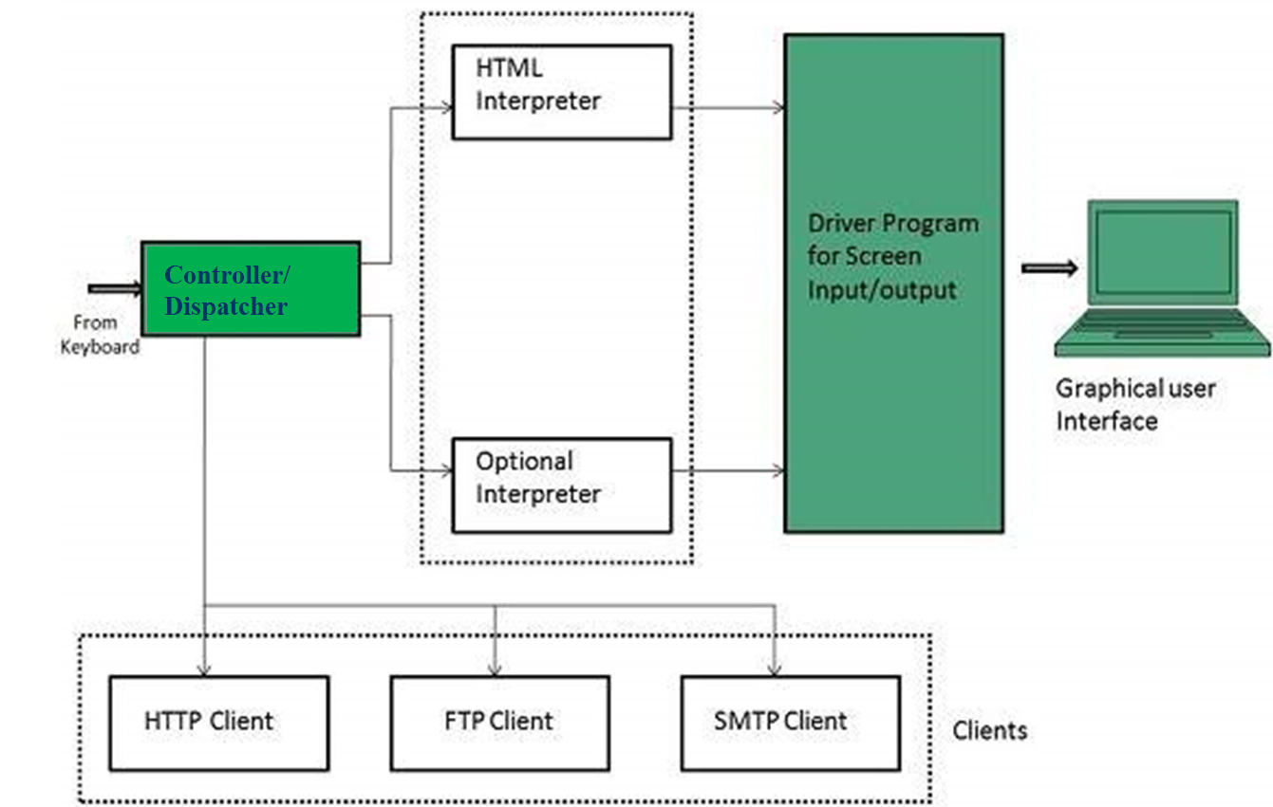
Browser Architecture

Slide 10
Web server
Web server is a computer where the web content is stored. Basically web server is used to host the web sites but there exists other web servers also such as gaming, storage, FTP, email etc.

Slide 11
Web server Working
Web server respond to the client request in either of the following two ways:
Sending the file to the client associated with the requested URL.
Generating response by invoking a script and communicating with database

Slide 12
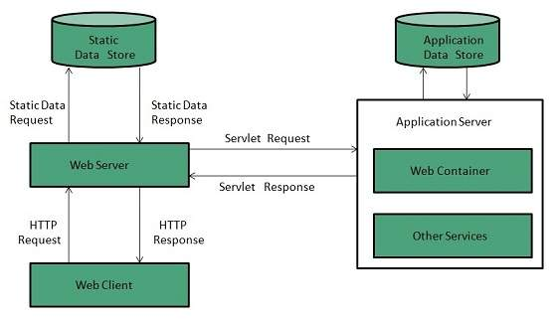
Web server Working

Slide 13
Key Points
When client sends request for a web page, the web server search for the requested page if requested page is found then it will send it to client with an HTTP response.
If the requested web page is not found, web server will the send an HTTP response: Error 404 Not found.
If client has requested for some other resources then the web server will contact to the application server and data store to construct the HTTP response.

Slide 14
Web Server Architecture
Web Server Architecture follows the following two approaches:
Concurrent Approach
Single-Process-Event-Driven Approach.

Slide 15
Concurrent approach
Concurrent approach allows the web server to handle multiple client requests at the same time. It can be achieved by following methods:
Multi-process
Multi-threaded
Hybrid method.

Slide 16
Multi Processing
In this a single process (parent process) initiates several single-threaded child processes and distribute incoming requests to these child processes. Each of the child processes are responsible for handling single request.
It is the responsibility of parent process to monitor the load and decide if processes should be killed or forked.

Slide 17
Multi Threaded
Unlike Multi-process, it creates multiple single-threaded process.

Slide 18
Hybrid
It is combination of above two approaches. In this approach multiple process are created and each process initiates multiple threads. Each of the threads handles one connection. Using multiple threads in single process results in less load on system resources.

Slide 19
Example
Apache HTTP Server
Internet Information Services (IIS)
Lighttpd
Sun Java System Web Server
Jigsaw Server

